Slide 1
Approach Details Ministry Name : Ministry of Communications Problem Statement : Identification of optimal set of multiple interceptor launch areas to maximize the destruction of multiple air targets Team Name : Team Leader Name : Yashi Srivastava College Code : VIT

Slide 2
Idea / Approach details
For each given interceptor, the missiles it can target is calculated and stored. Interceptor clusters are sorted by amount of missiles it can target. Minimum interceptors needed to target all missiles is also calculated. Then by taking top ‘n’ clusters the inverse of sum square is calculated for each ‘n’. A curve fitting algorithm is used to get a continuous function which is then minimized and rounded off to get the best set of ‘n’ interceptor coordinates (polygon).
Python, Greedy algorithm to find minimum numbers of interceptors needed to target all the missiles and the missiles in range of each interceptor, Scipy, Curve fitting (Levenberg-Marquardt algorithm) to make a continuous function from the discrete inverse sum of squares function, Minimizing the inverse sum of squares (using COBYLA, SLSQP and trust-constr methods).

Slide 3
Idea / Approach details
Describe your Use Cases here
Multiple curve fitting and optimization algorithms for best solution. Discrete problem is approximated to continuous problem which is easier, faster and more accurate to solve. Error percentage and the ‘inverse probability function’ (inverse of sum square) can be plotted to show the user the best solution. Graphical Interface can be generated on demand to show the topography.

Slide 4
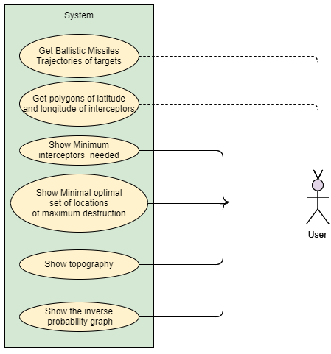
Use case diagram

